Slide 1

Promoter architecture and sex-specific gene expression in the microcrustacean Daphnia pulex revealed by profiling of 5’-mRNA ends
R. Taylor Raborn
Postdoctoral Fellow
Department of Biology,
Indiana University
@rtraborn
Regulatory Genomics SIG

Slide 2
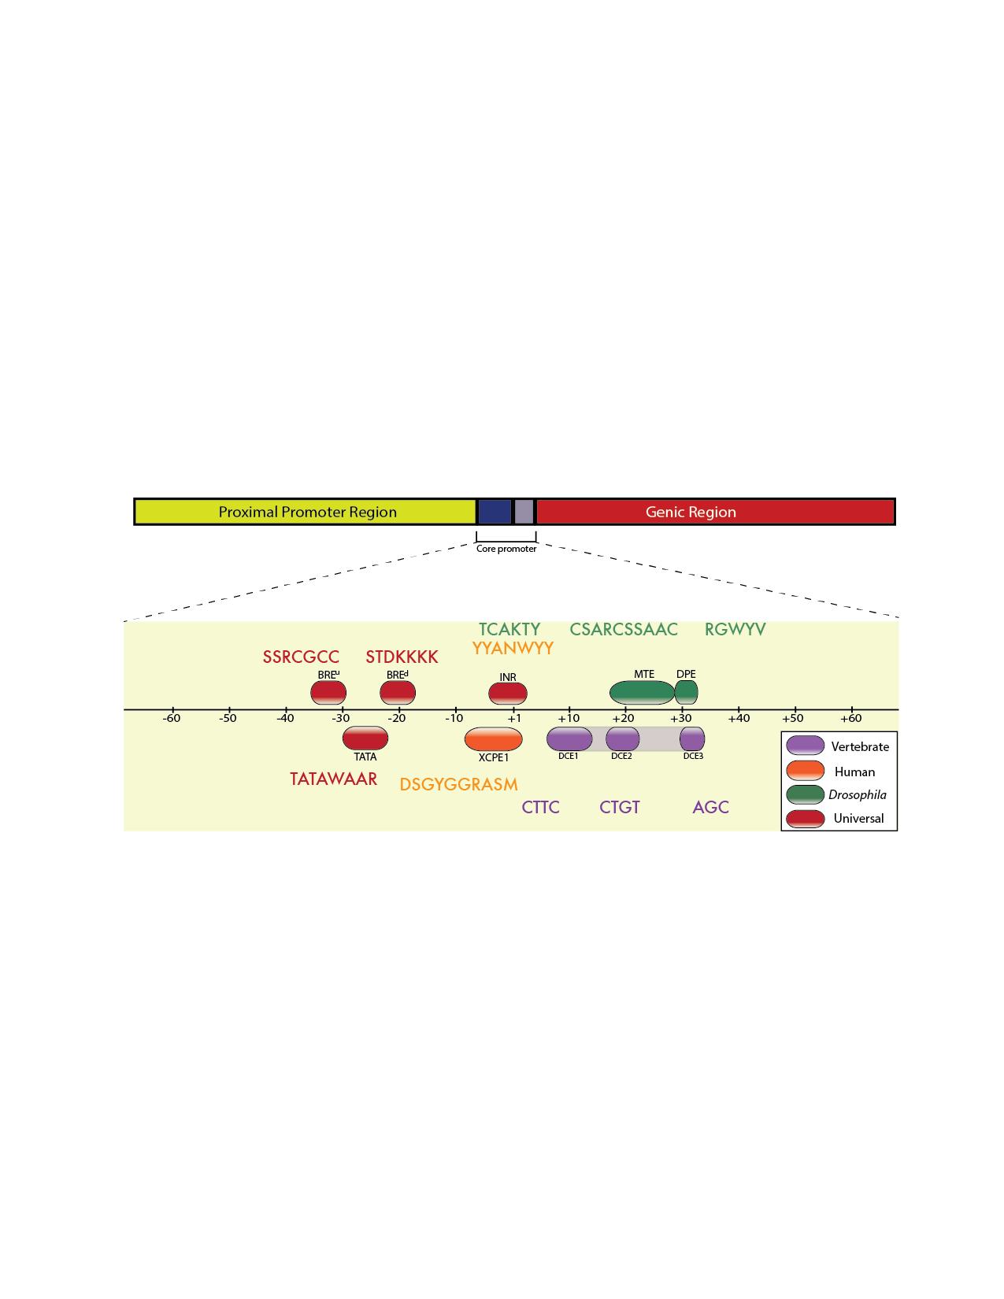
The composition of metazoan promoters is heterogeneous
Adapted from Lenhard et al., 2012

Slide 3

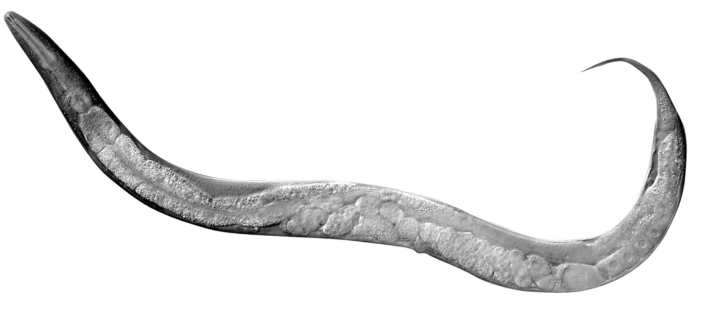
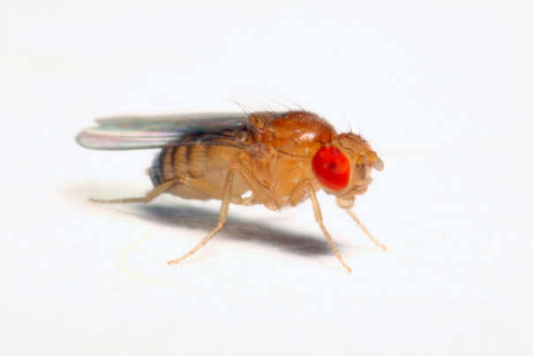
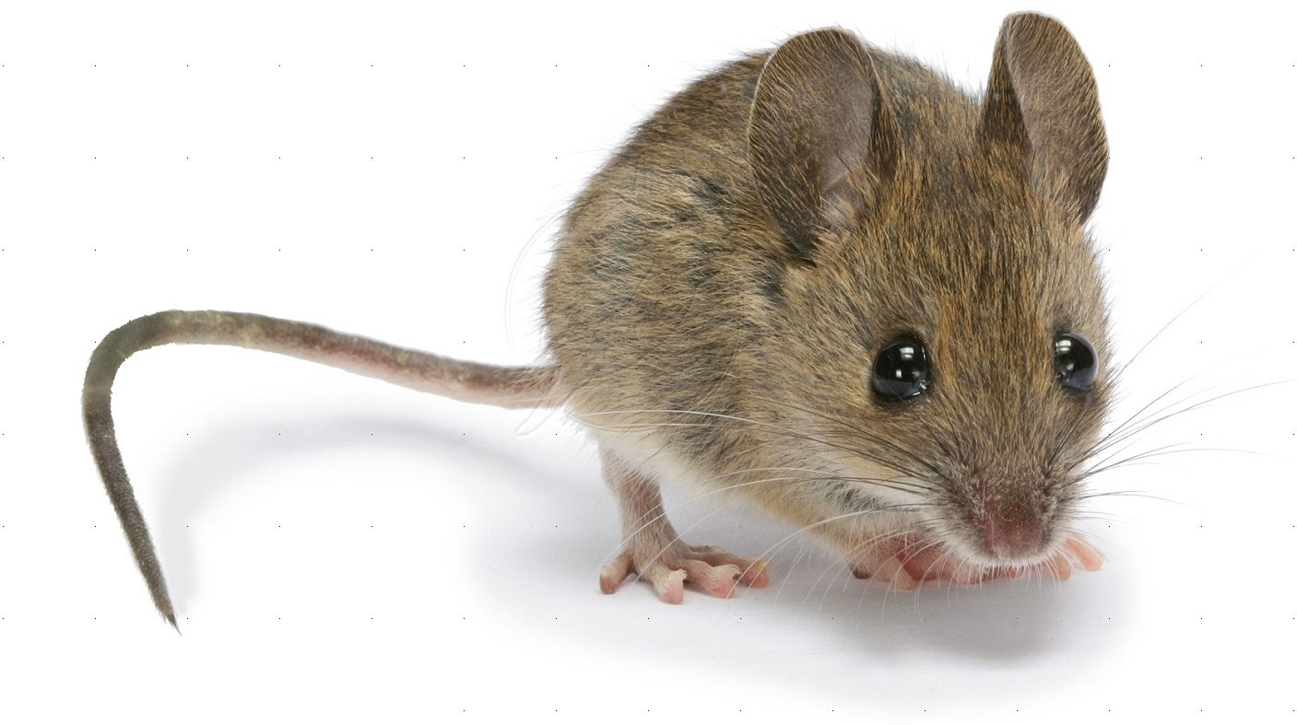
Our understanding of metazoan promoters is phylogenetically limited
Most of what is known about metazoan promoters comes from a small set of major model organisms.
Adapted from Lenhard et al., 2012

Slide 4
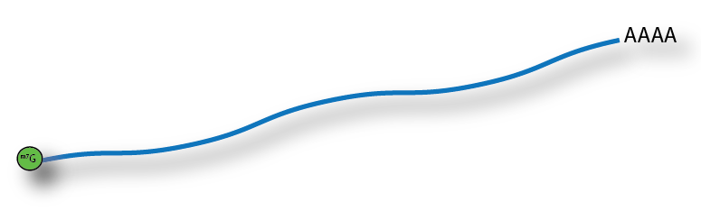

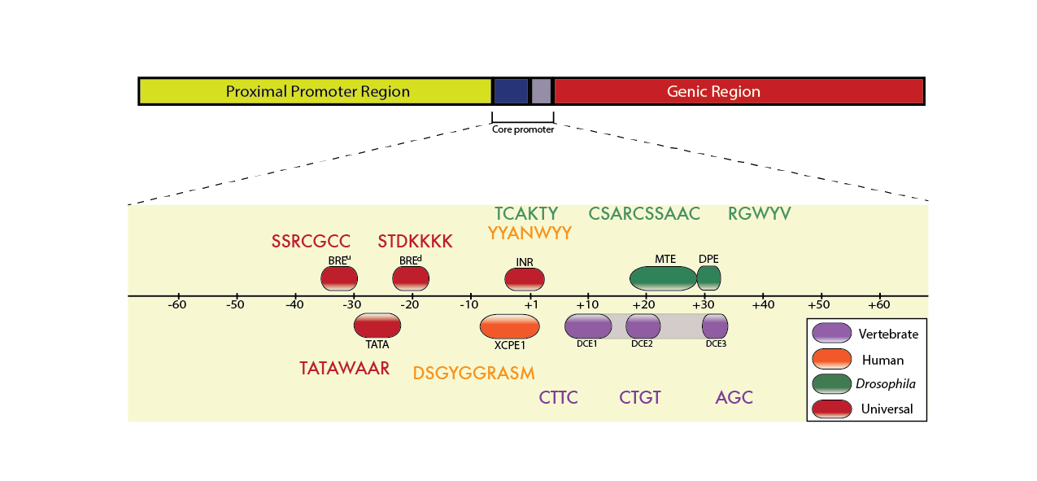
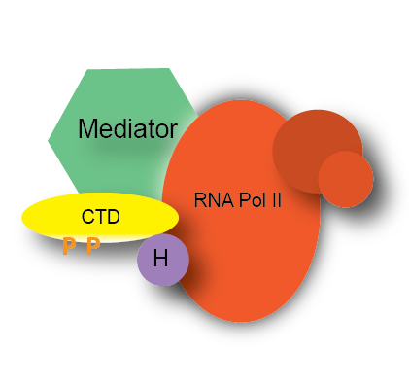
The transcription start site (TSS) provides a link between promoter and mRNA
Pre-initiation Complex (PIC)

Slide 5
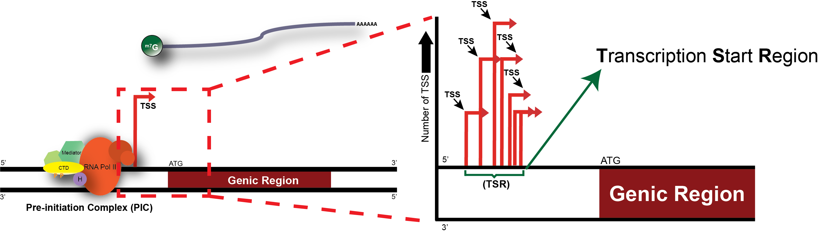

Slide 6
Cap Analysis of Gene Expression (CAGE) identifies TSSs of mRNAs at large scale
Cap trapping:
Biotylation followed by
pulldown with streptavadin beads
5’ and 3’ linker ligation
Linker
CAGE tag
Linker
Align CAGE tags (47bp) to genome
We sought to expand the phylogentic breadth of metazoan core promoters by applying CAGE in D. pulex
Carninci et al., 2006; Murata et al., 2014

Slide 7
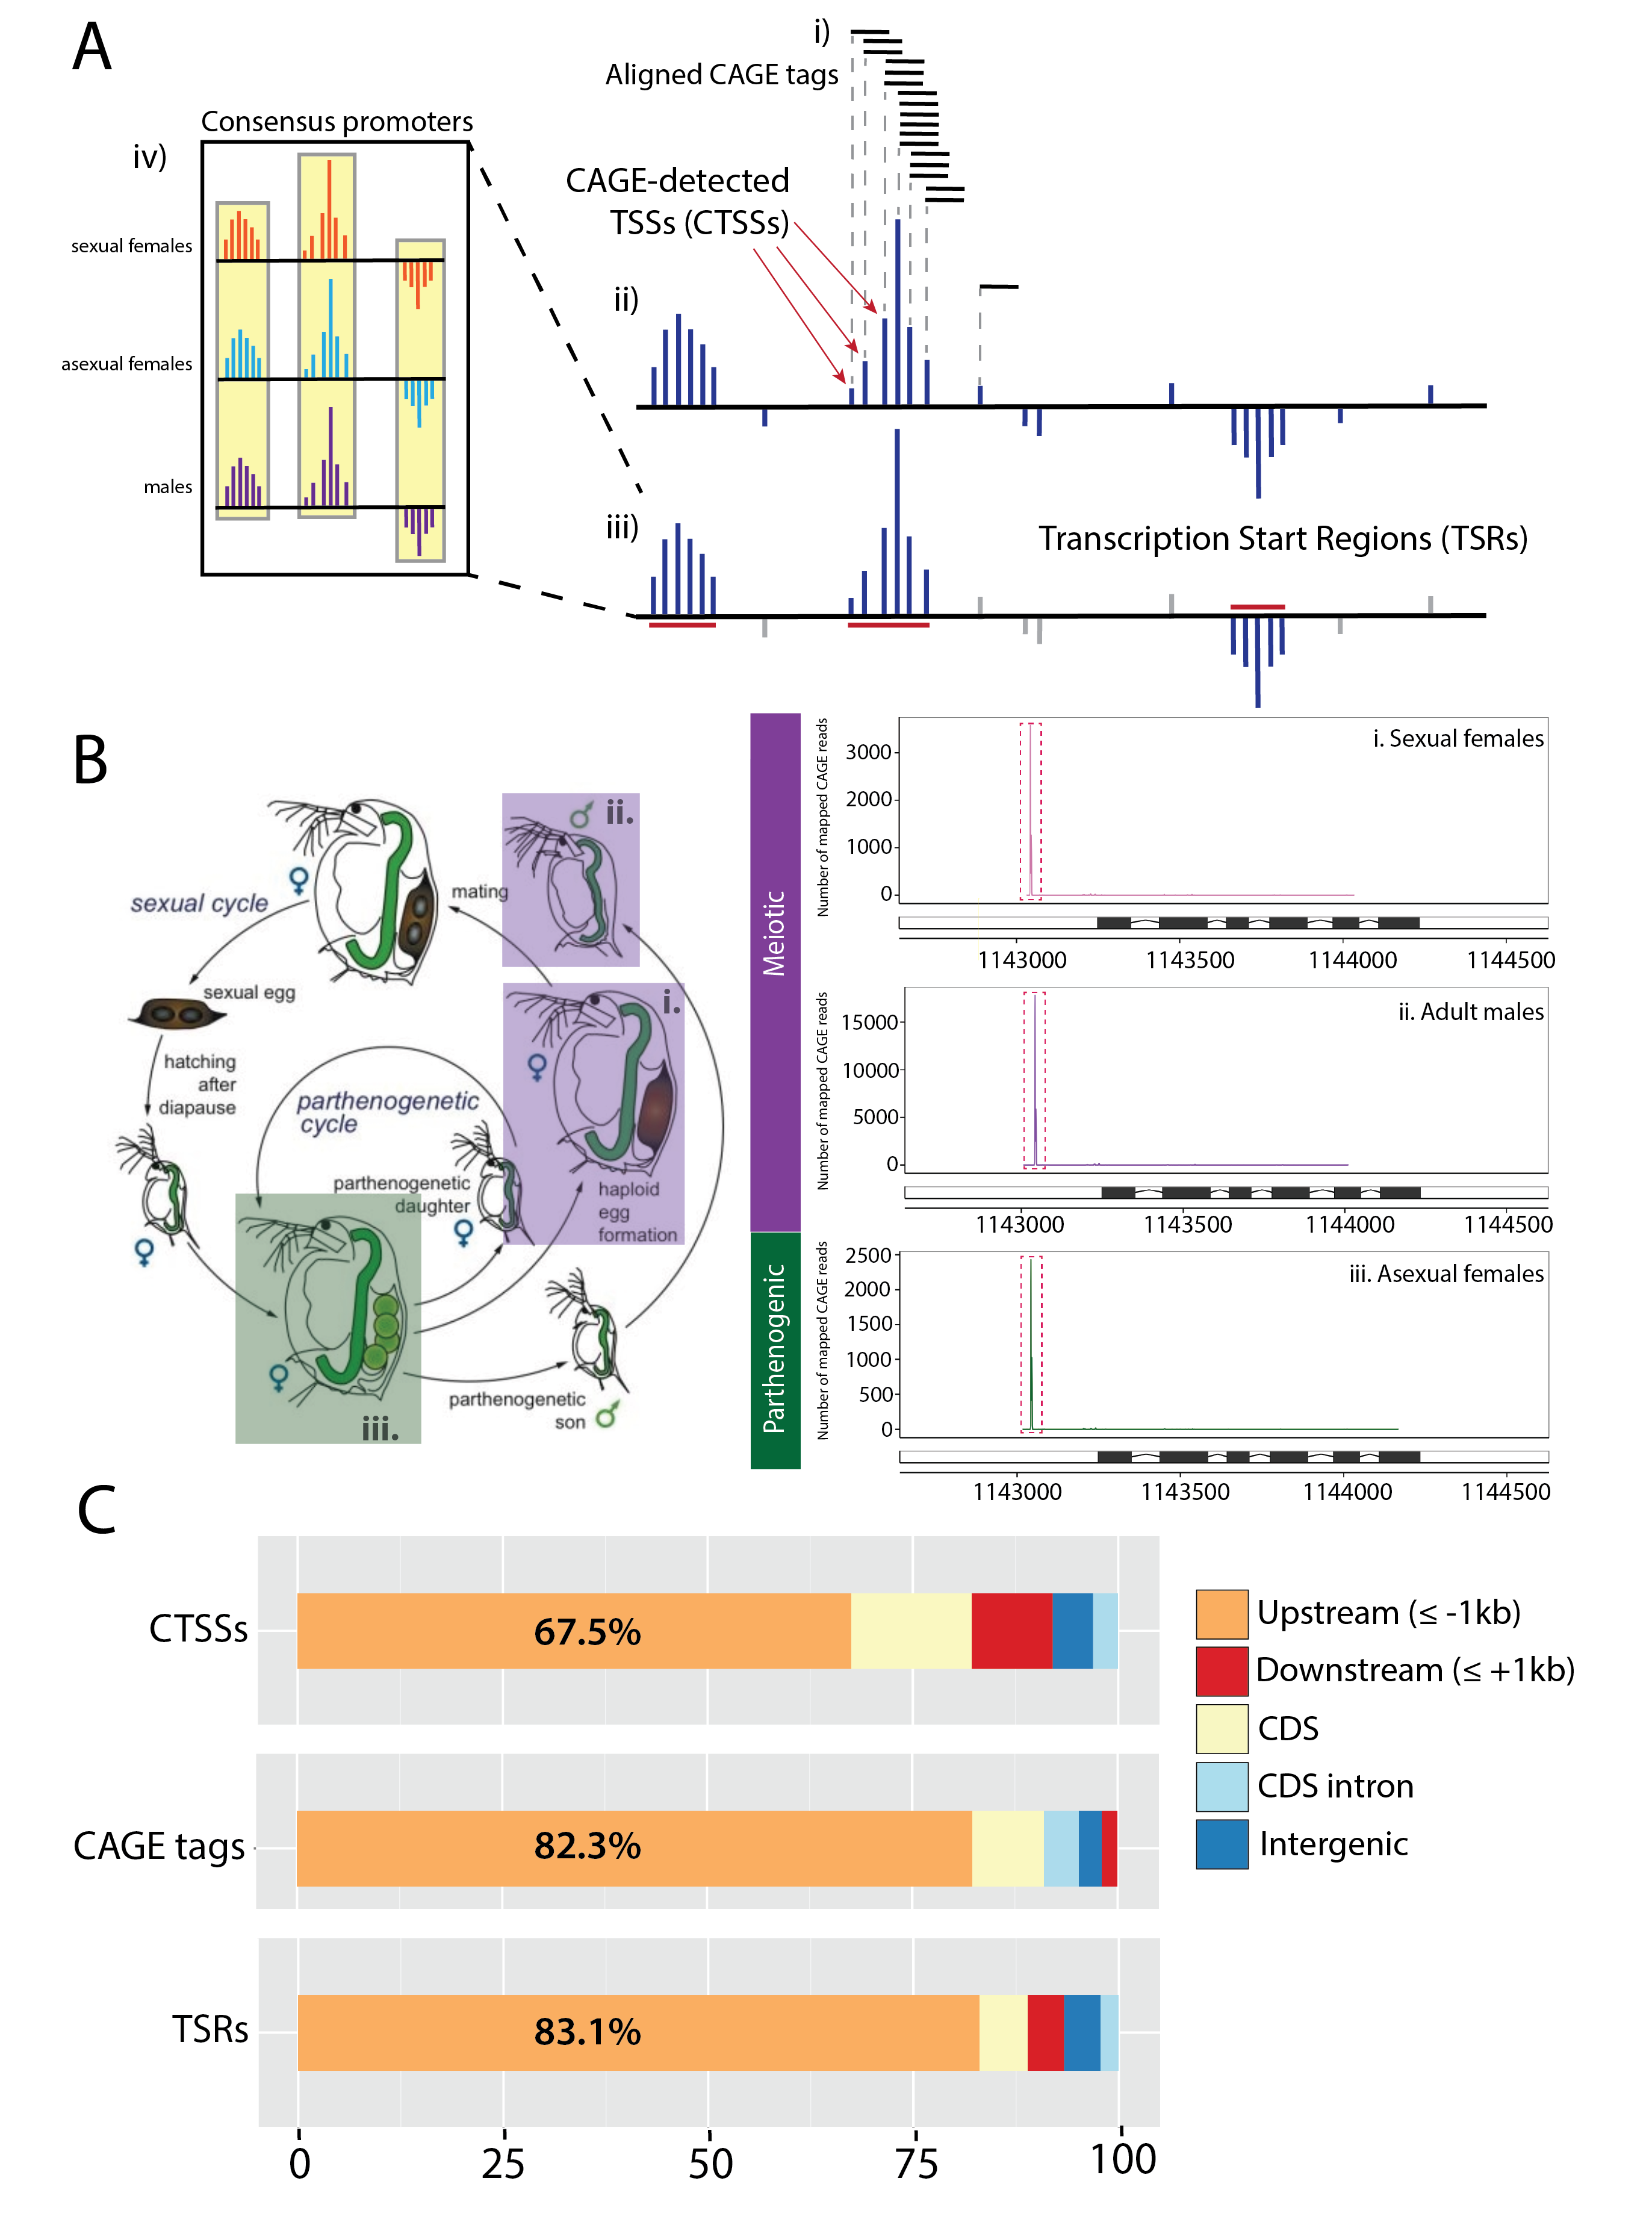
Designations of CAGE-based information
Raborn et al., 2016. Submitted

Slide 8
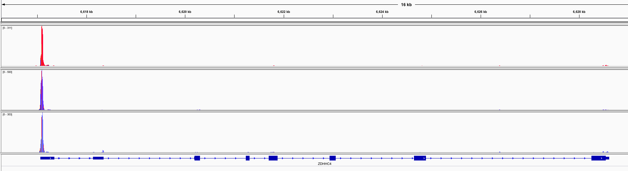
CAGE identifies the global landscape of transcription initiation
Peaks of aligned CAGE tags
hg19
Cell line
Gm12878
H1-hESC
K562
Gencode v7
Gene: ZDHHC4
Snapshot from IGV. CAGE data from ENCODE/UCSC.
Notes:
Gene ZDHHC4 is Zinc Finger DHHC-Type Containing 4.
GO annotations related to this gene include cytochrome-c oxidase activity and protein-cysteine S-palmitoyltransferase activity. An important paralog of this gene is ZDHHC1.

Slide 9
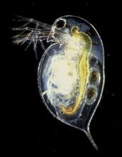
Daphnia pulex is an emerging model organism for genetics
Daphnia spp. are globally distributed; nearly ubiquitous in freshwater habitats
Many diverse, well-characterized natural populations
A unique life cycle that includes both sexual and asexual modes of reproduction
Image Credit: Paul Hebert

Slide 10
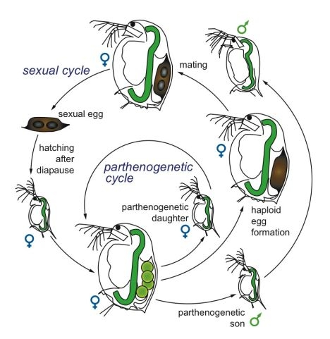
Daphnia’s life cycle comprises sexual and asexual reproductive pathways
Image Credit: D. Ebert, 2005.

Slide 11
D. pulex has a compact, gene-rich genome
Assembly Summary (“TCO”)
Annotation Summary
Criterion% | D. pulex JGI v1.1
Number of scaffolds | 5,191
Ave. length of scaffolds (bp) | 9,660
Length of N50 scaffold (bp) | 318,519
Length of largest scaffold (bp) | 4,193,030
Length of scaffolds (bp) | 197,261,574
Number of chromosomes | 12
Estimated genome length (bp) | 260,000,000
Number of annotated genes | 30,907
GC content (%) | 41.6
Ave. intron length (bp) | 170
%Note: only results from nuclear genome are shown
Colbourne et al. 2011. Science 331:555-561

Slide 12
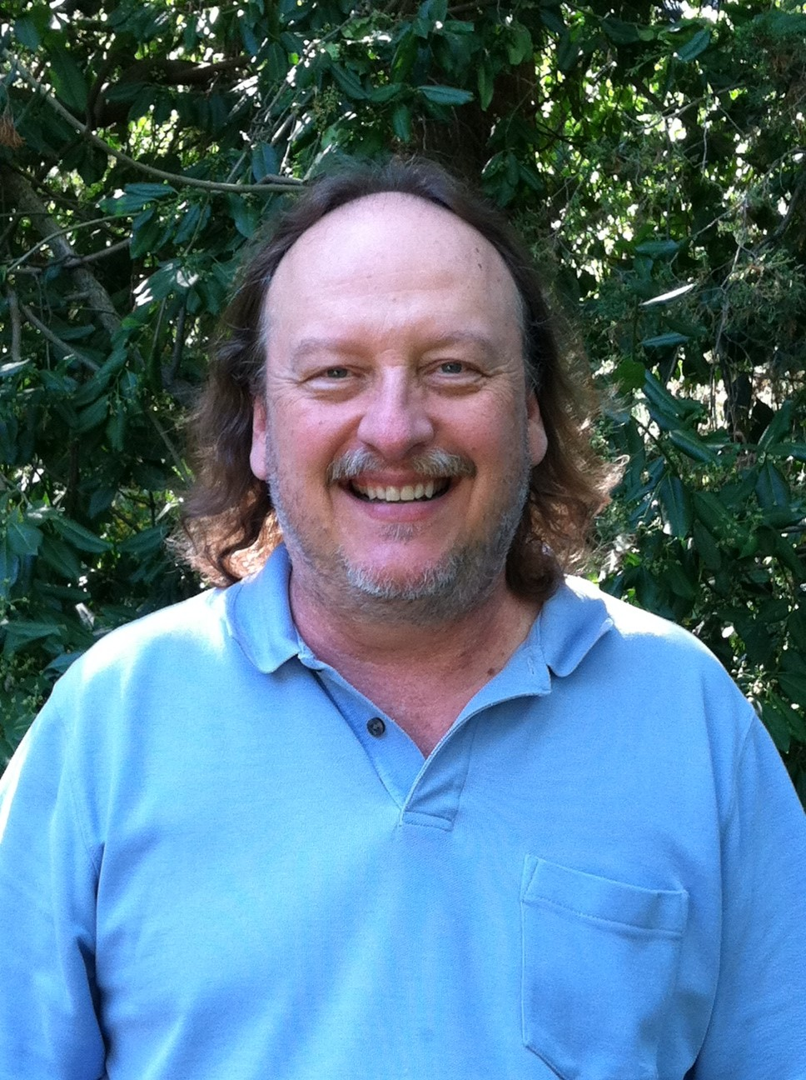
Culturing and RNA isolation of D. pulex
We collected Daphnia individuals from three states using manual culturing and size separation.
Total RNA isolated from whole individuals (n=50-100) using mechanical disruption and cell lysis.
Individuals derived from a clone (PA42) originating from a well-characterized natural population in Indiana (Lynch et al., 1989).
with Ken Spitze, PhD
M. Lynch, K. Spitze, and T. Crease, Evolution. 1989.

Slide 13
Preparation and analysis of CAGE libraries
CAGE libraries (DNAForm, Japan) were made using biological replicates from three states in D. pulex.
Sequenced using the Illumina HiSeq 2000 platform (50bp, SE)
Aligned reads to D. pulex assembly TCO v1.1 using bwa (Li and Durbin, 2009)
Applied CAGE analysis pipeline: clustering and identification of CTSSs, TSRs and consensus promoters using CAGEr (Haberle et al., 2014).
#nAnT-iCAGE; M. Murata et. al., 2014.

Slide 14
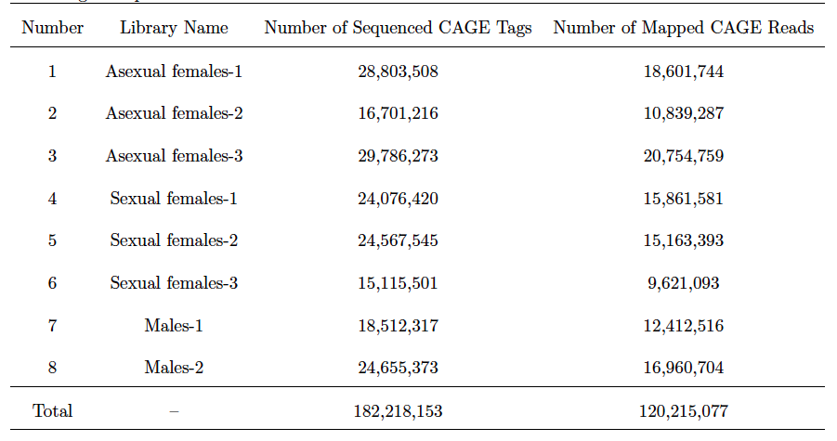
Summary of sequenced CAGE libraries
Raborn et al., 2016. Submitted

Slide 15
CAGE mapping and promoter identification summary
Sample Name | Number of Mapped Reads | Putative TSRs (unique) | Consensus TSRs
Asexual females | 50,195,790 | 11,496 (316) | ⏤
Sexual females | 40,636,067 | 11,289 (231) | ⏤
Adult males | 29,373,220 | 11,558 (557) | ⏤
Total | 120,215,077 | 12,662 | 10,665
2,332,582 CTSSs
Raborn et al., 2016. Submitted

Slide 16
Majorities of CAGE tags and promoters are found in 5’ upstream regions
Percent of Total
Raborn et al., 2016. Submitted

Slide 17
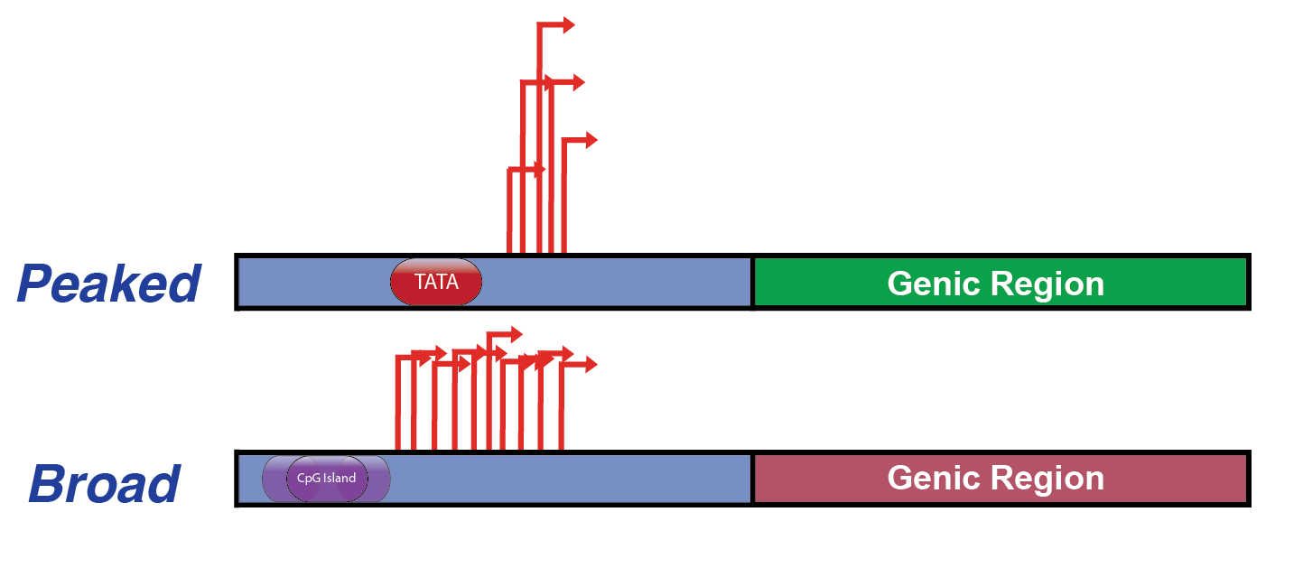
Shape of TSSs at a promoter is associated with expression properties
Regulated, tissue-specific genes
Peaked
Broad
Constitutively expressed, “housekeeping” genes
Carninci et al., 2006
Lenhard et al., 2012
Model from results in fruit fly, mammals

Slide 18
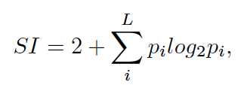
Shape classification of CAGE-identified promoters
Promoter
Width: the length of the genomic segment
occupied by the TSR.
Shape: the disorder of TSSs within a TSR.
# of CAGE tags/CTSS
width
T
Hoskins et al., 2011.

Slide 19
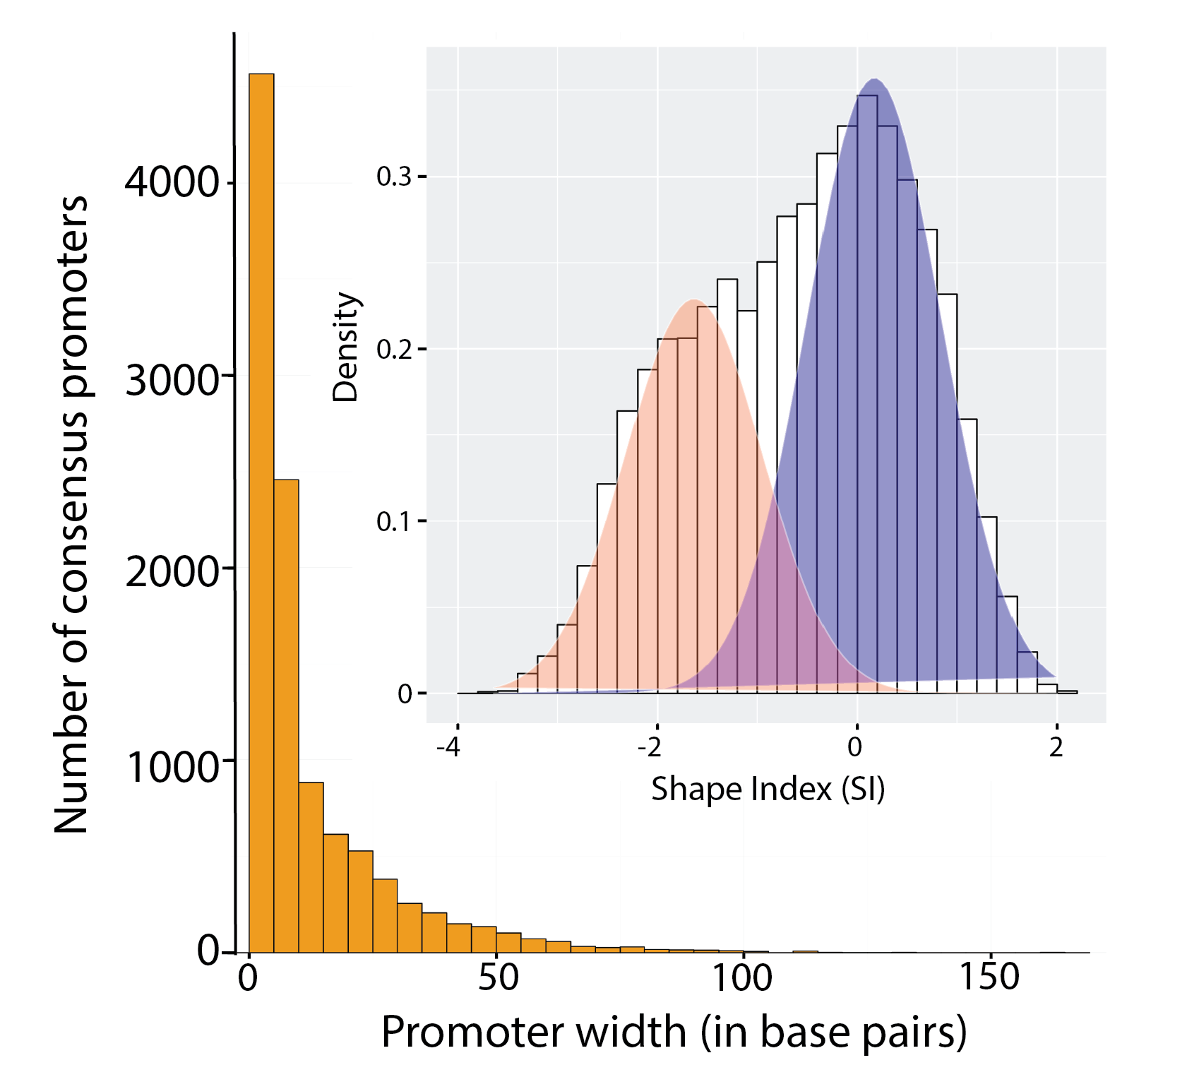
CAGE-identified promoters in D. pulex exhibit a range of shape properties
Raborn et al., 2016. Submitted

Slide 20
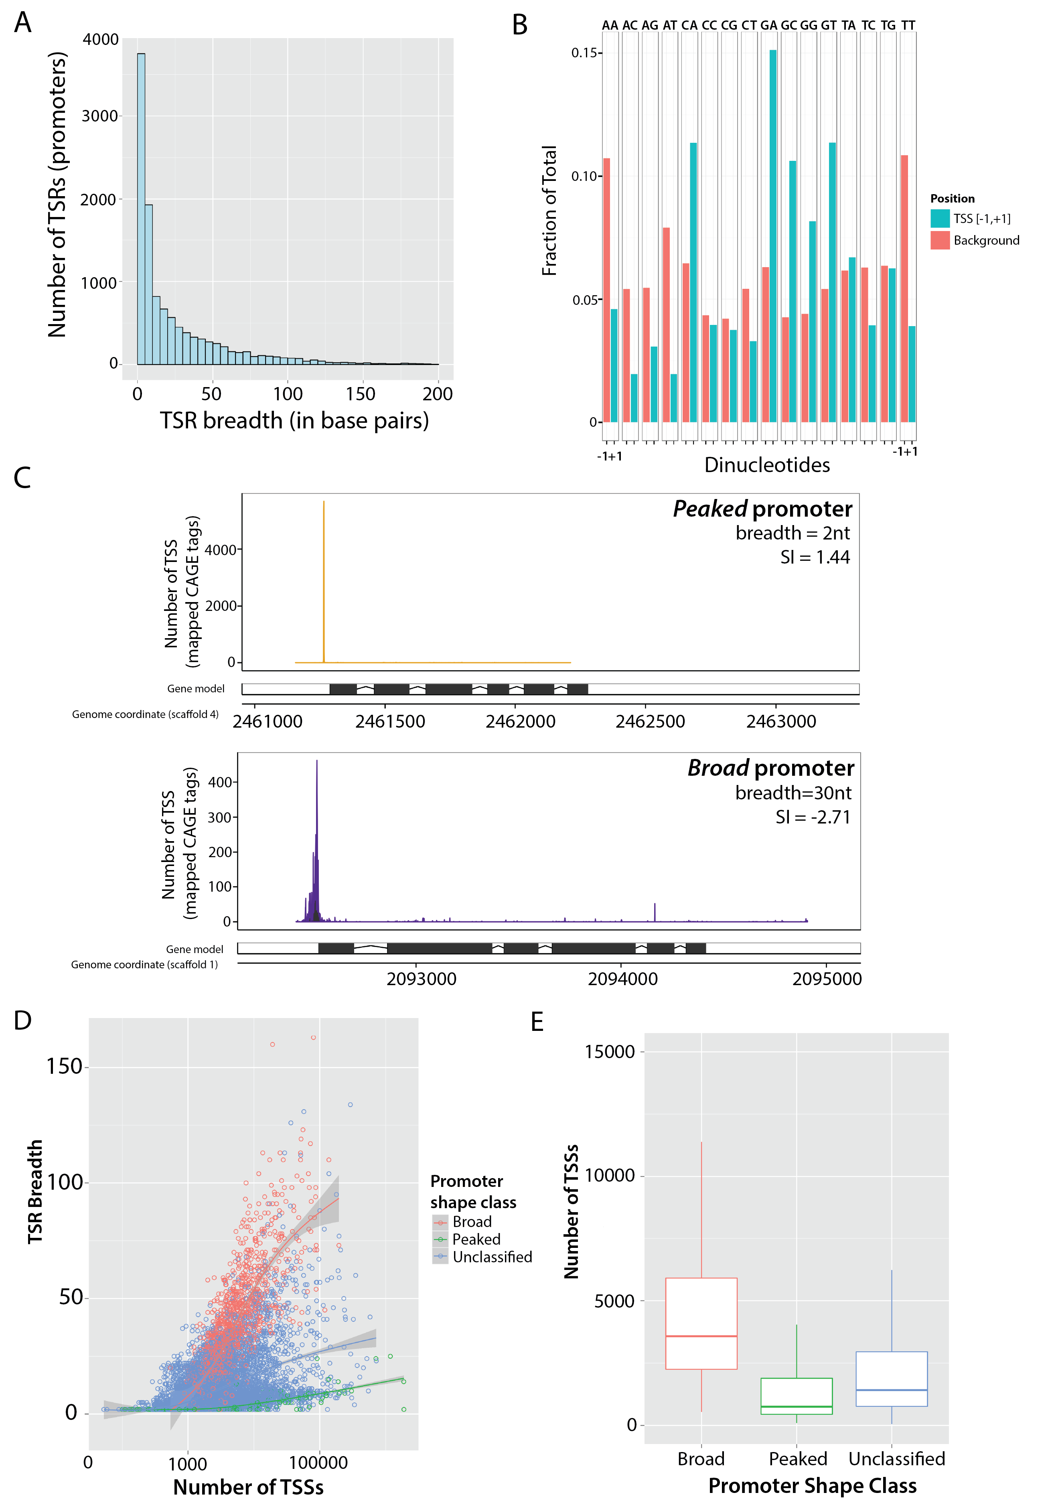
CAGE-identified promoters in D. pulex exhibit a range of shape properties
Raborn et al., 2016. Submitted

Slide 21
Broad promoters are more highly expressed than peaked promoters
**
**p < 0.0004
Raborn et al., 2016. Submitted

Slide 22
De novo discovery of D. pulex core promoter motifs
+1
Retrieved sequences [-50, +50] surrounding CAGE peaks
Identified over-represented motifs (HOMER)
Performed cross validation to statistically verify all identified motifs
Compared motifs to panel of core promoter elements in D. melanogaster.
-50
+50
Heinz et al., 2010 (HOMER)
Raborn et al., 2016. Submitted
With Yao Xiangyu
Notes:
Retrieved genomic regions (window: [-50,+50]) surrounding enriched CAGE peaks
Identified enriched motifs within the target regions relative to background
Applied the hypergeometic enrichment algorithm within HOMER (Heinz et al., 2010)
Obtained >25 putative core promoter motifs above background

Slide 23
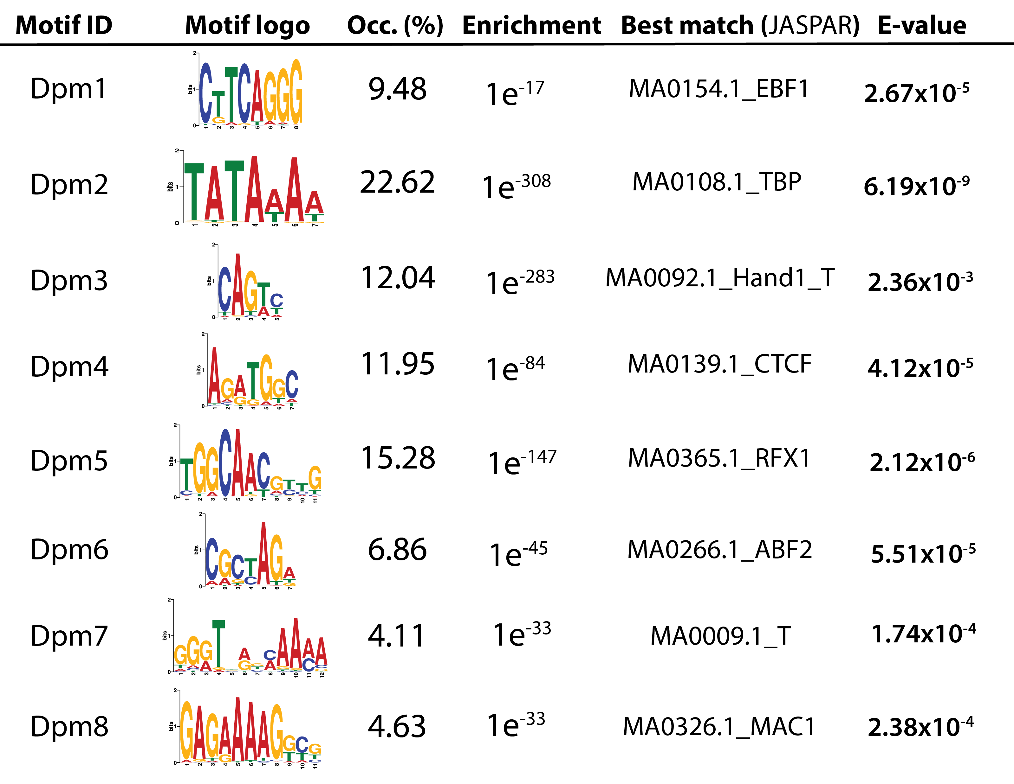
Validated D. pulex core promoter motifs
TATA
Initiator
Ohler8
Ohler et al. 2002.
Raborn et al., 2016. Submitted

Slide 24
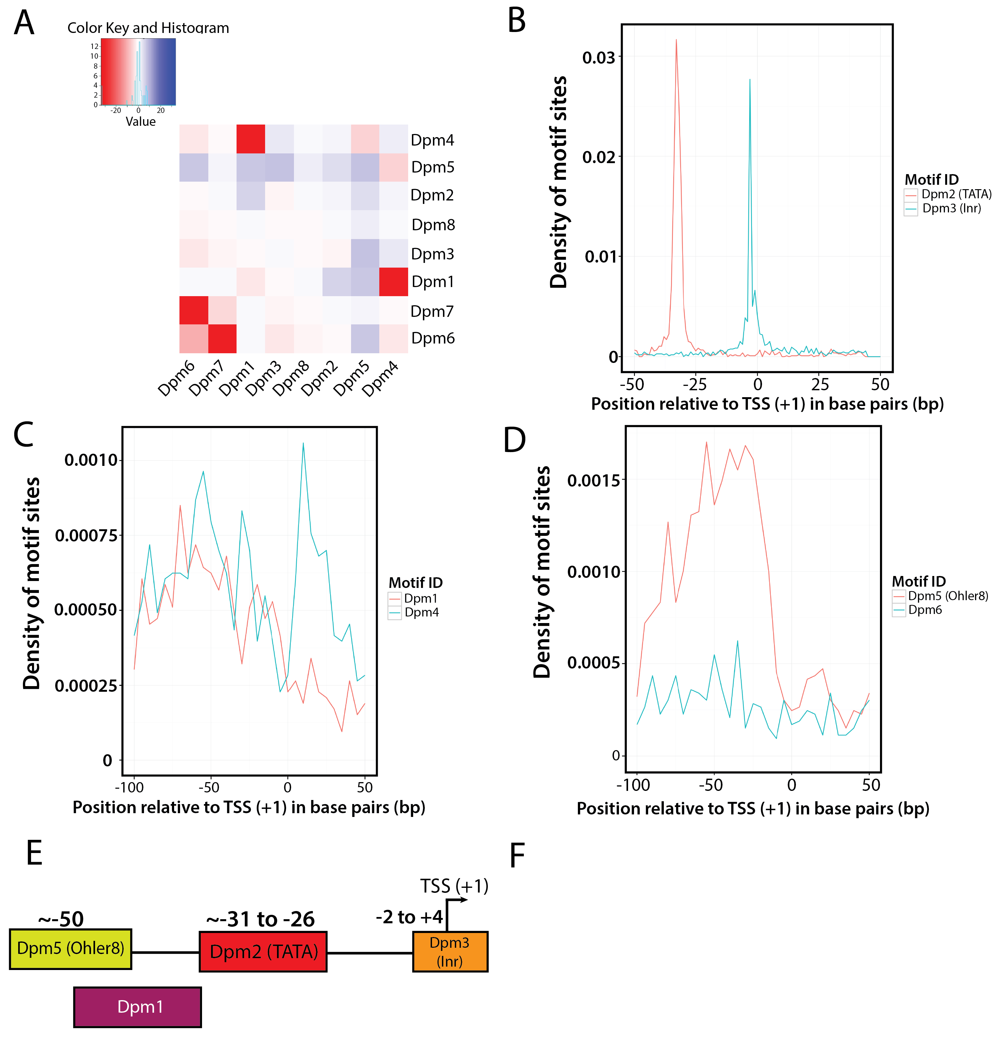
TATA and Inr exhibit expected enrichments relative to +1
Dpm2 (TATA)
Dpm3 (Inr)
Raborn et al., 2016. Submitted

Slide 25
Dpm5 (Ohler8-like) is enriched between -40 and -60
Dpm5 (Ohler8-like)
Raborn et al., 2016. Submitted
Ohler et al. 2002.

Slide 26
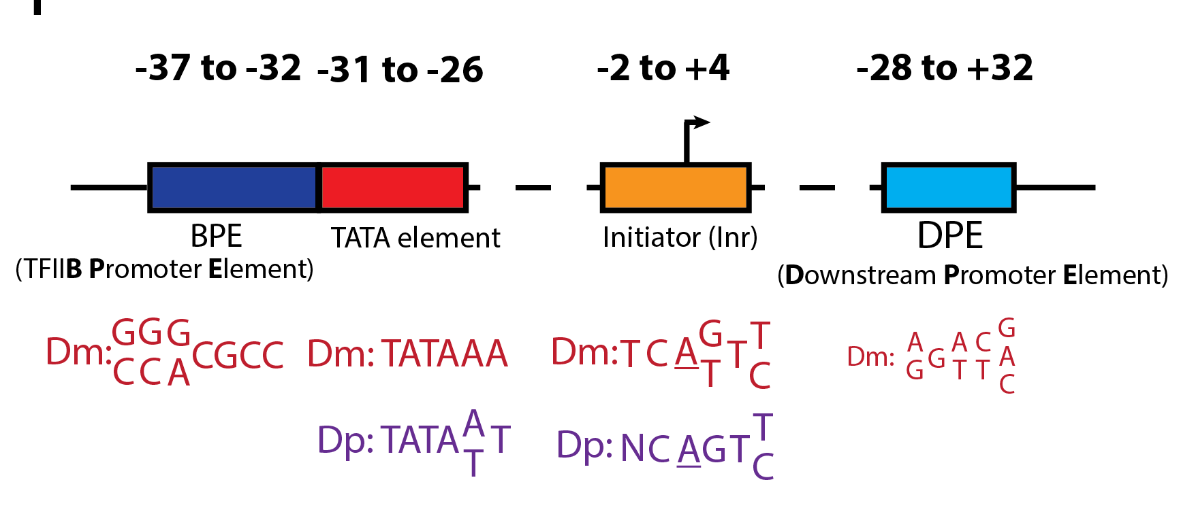
Current model of Daphnia core promoter architecture
Adapted from Kadonaga, 2012.
Raborn et al., 2016. Submitted

Slide 27
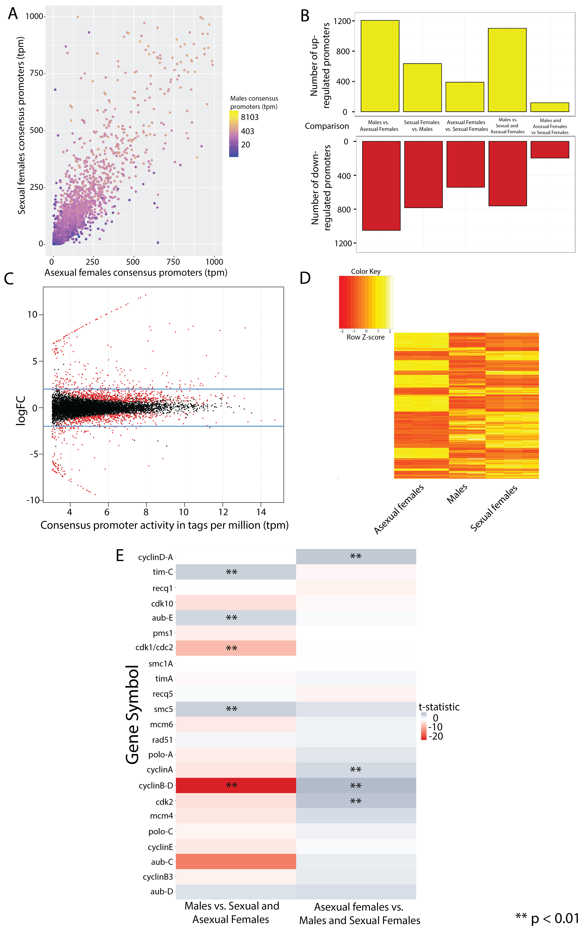
Differential promoter activity by developmental state
Normalized abundance at a consensus promoter
Raborn et al., 2016. Submitted

Slide 28
We observe differential promoter activity by developmental state
Raborn et al., 2016. Submitted

Slide 29
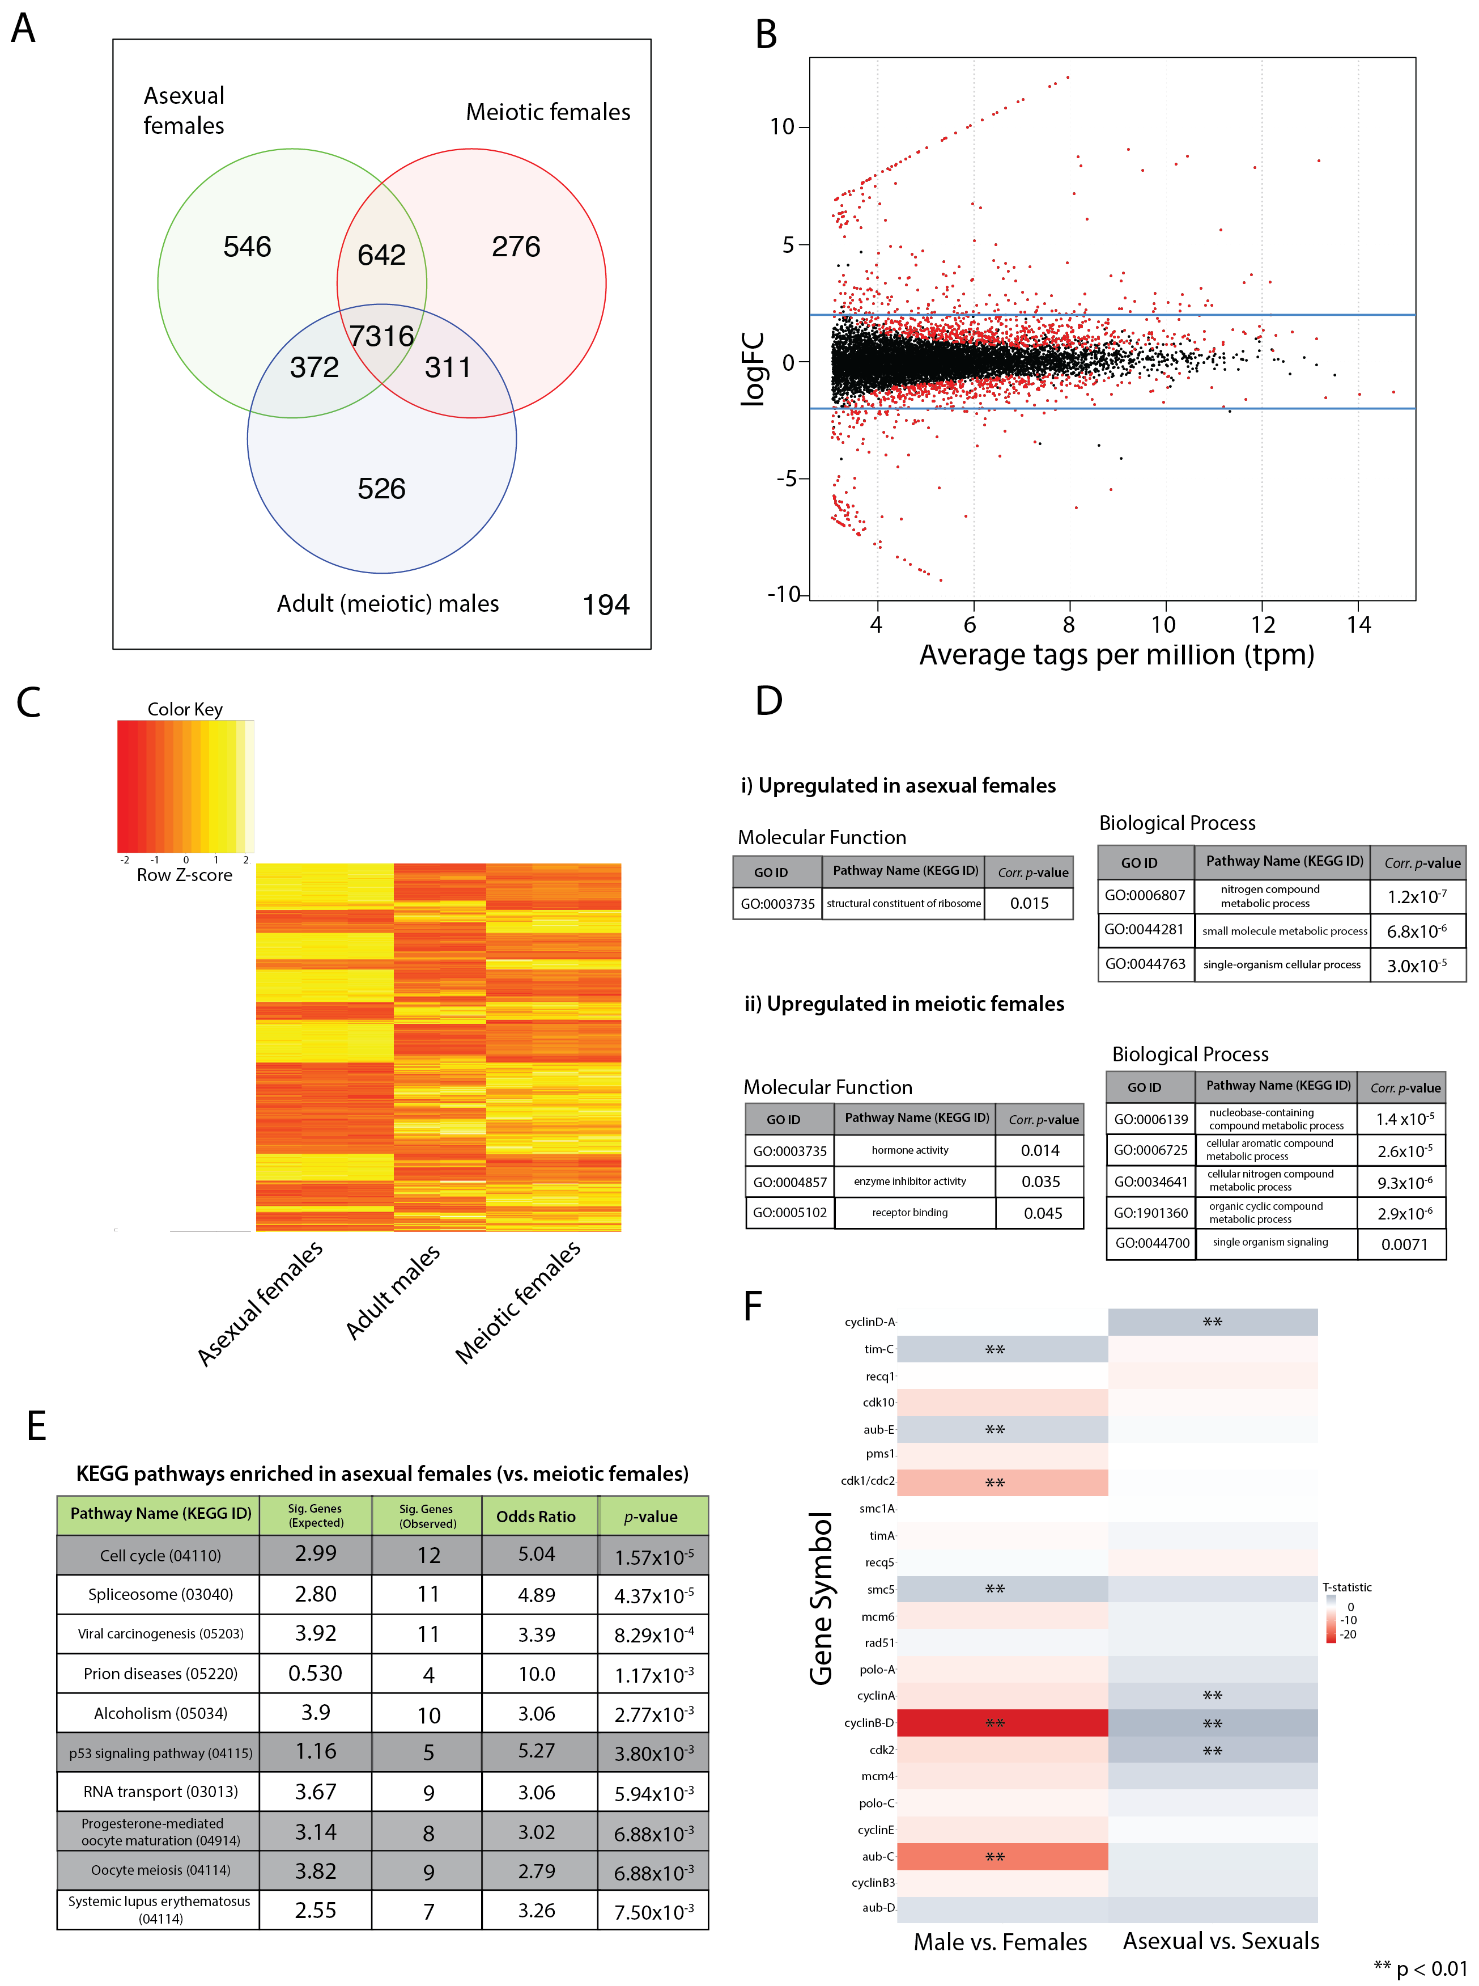
Meiosis and cell cycle genes are associated with differential promoter activity in sexual vs. asexual Daphnia females
Asexual females
Sexual females
Raborn et al., 2016. Submitted

Slide 30
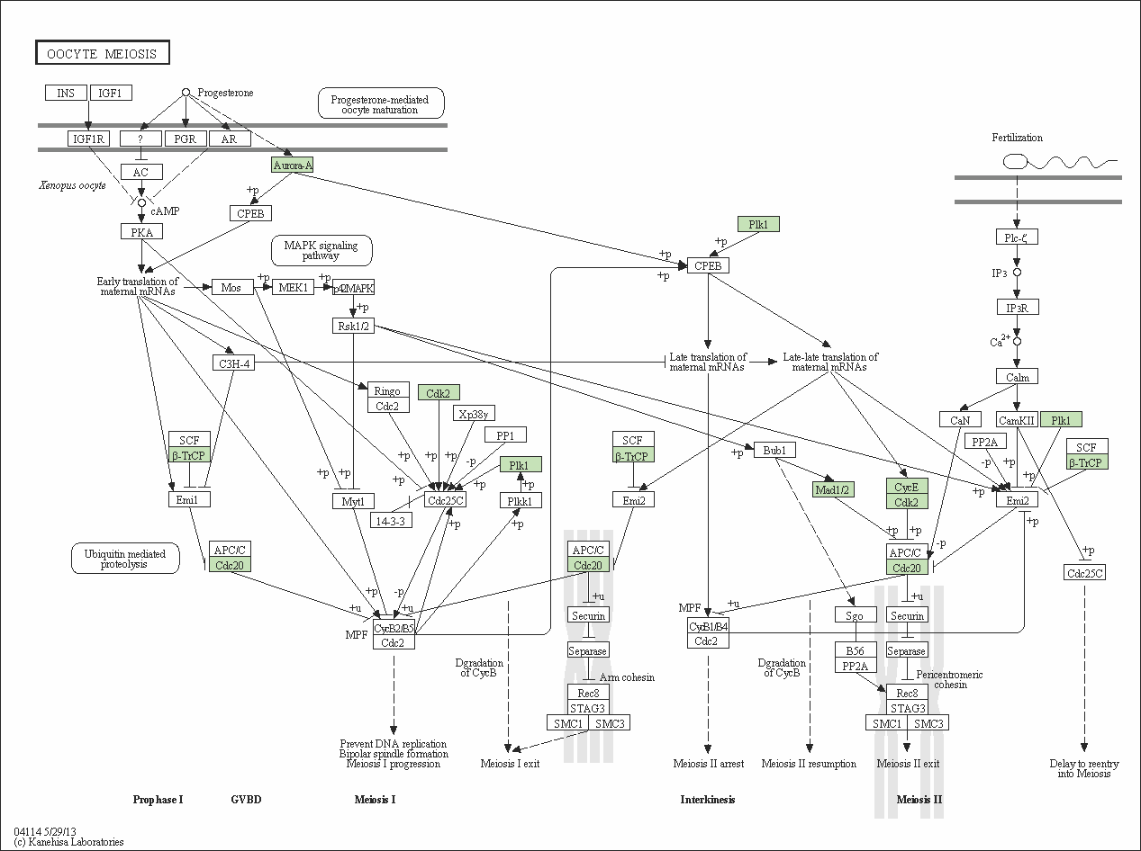
Differential CAGE-estimated expression of meiotic genes
We investigated the activity of promoters associated with meiosis genes (Schurko et al., 2009).
Unexpectedly, we find differential up-regulation in the activities of meiosis gene promoters
cyclinA, cyclinB-D, cyclinD-A, cdk2, cdc20, plk1
Negative regulation of meiosis I progression.
Raborn et al., 2016. Submitted

Slide 31
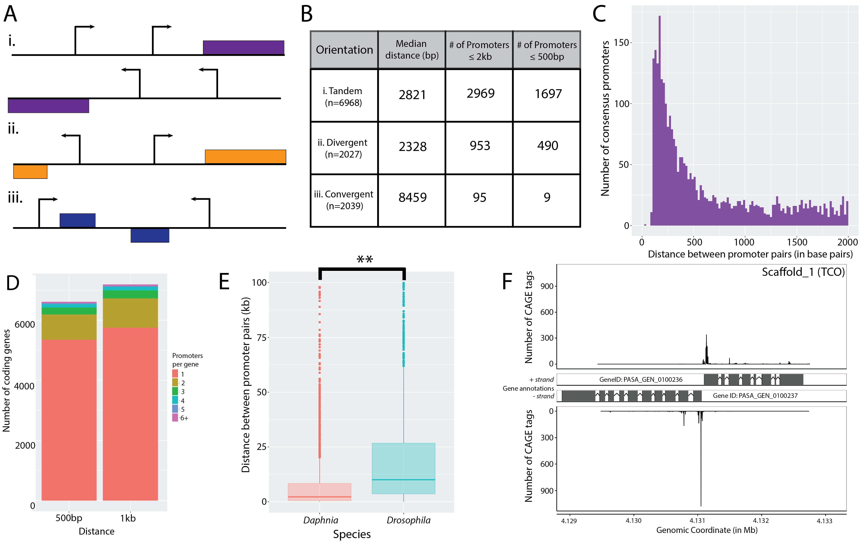
D. pulex exhibits widespread alternative promoter usage
Nearly 1/5th (19.1%) of genes measured have multiple promoters.
6000
Promoters in compact, tandem orientation
4000
Number of annotated coding genes
2000
0

Slide 32
Summary
We identified more than 12,000 D. pulex promoters using CAGE
D. pulex promoters exhibit shape properties consistent with other metazoans
Discovered eight distinct core promoter motifs in D. pulex, including TATA and Initiator (Inr)
Identified patterns of sex-specific gene expression
Observed widespread promoter usage is widespread in D. pulex
A high proportion of promoters are in head-to-head orientation

Slide 33


Acknowledgements
Contributors
Funding
Volker Brendel
Michael Lynch
NIH R01 (M. Lynch) “Population genomics of Daphnia pulex”
(Award 1R01GM101672-01A1)
Yao Xiangyu
Ken Spitze
Kimberly Young
The Brendel Group is supported by NSF.
Sequencing services: Vincent J. Coates Genomics Sequencing Laboratory at UC Berkeley, supported by two NIH S10 Instrumentation Grants.
Critical Comments
Peter Cherbas
Nathan Keith
Dave Tang
Sen Xu

Slide 34
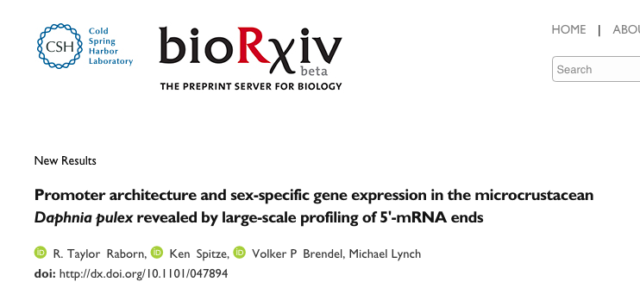
Please check out our pre-print of this work on bioRxiv
http://dx.doi.org/10.1101/047894

Slide 35


